Slide 1

BST 209 Machine Learning: Collaborative Data Science in Healthcare
Summer 2, 2021

Slide 2
Agenda
Introductions
Course overview
Introduction to R Markdown
Introduction to R

Slide 3
Virtual Etiquette
During lecture please keep yourself muted unless you would like to ask/answer a question
You may ask questions by unmuting yourself or through the chat
This is a safe space and no question is dumb or pointless

Slide 4
Introductions

Slide 5
Teaching Team
Heather Mattie Lecturer on Biostatistics Co-Director, Health Data Science Master’s Program hemattie@hsph.harvard.edu | Leo Celi Associate Professor (Part-time), HMS Principal Research Scientist, MIT lceli@mit.edu | Tom Pollard MIT Lab for Computational Physiology tpollard@mit.edu
Meg Salvia PhD Candidate Harvard T.H. Chan School of Public Health msalvia@g.harvard.edu | Jeff Joseph Harvard T.H. Chan School of Public Health jmjoseph@hsph.harvard.edu

Slide 6

AI-Vengers
Lasith Adhikari | Yugang Jia | Mira Moukheiber
Aldo Arevalo | Riccardo Levi | Sulaiman Moukheiber
Miguel Armengol | Yanran Li | Amber Nigam
Anushka Bhaskar | Sreekar Mantena | Mat Samuel
Francesco Carli | Dana Moukheiber | David Sasson
Jay Chandra | Lama Moukheiber
Notes:
Lasith Adhikari
Aldo Arevalo
Miguel Armengol
Anushka Bhaskar
Francesco Carli
Jay Chandra
Yugang Jia
Riccardo Levi
Yanran Li (students from Asia)
Sreekar Mantena
Dana Moukheiber
Lama Moukheiber
Mira Moukheiber
Sulaiman Moukheiber
Amber Nigam
Mat Samuel

Slide 7
Course Overview

Slide 8
Schedule
Week | Monday | Tuesday | Wednesday | Thursday | Friday
1 | - Introductions - Course overview - Introduction to RMarkdown - Introduction to R | - Data wrangling and curation | - Data wrangling and curation | - Data visualization - Data visualization principles - Exploratory data analysis | - Data visualization - Data visualization principles - Exploratory data analysis
2 | - Introduction to machine learning | - Machine learning continued | - Machine learning continued | - Machine learning continued | - Begin group project
3 | - Group project | - Group project | - Group project | - Group project | - Group project presentations

Slide 9
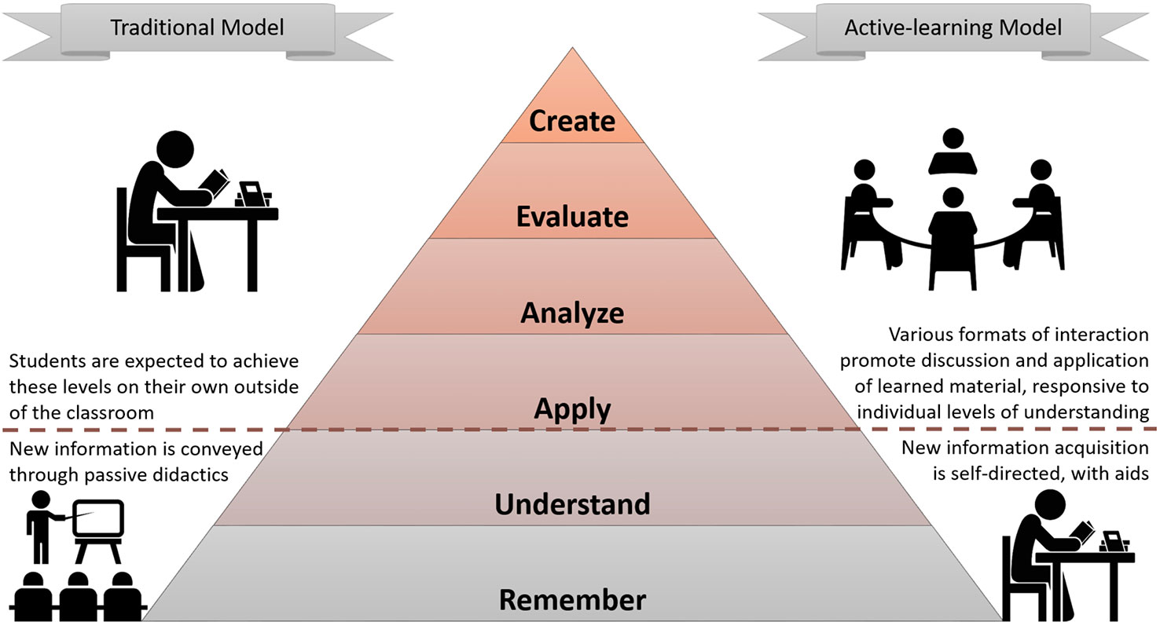

Course Format
Mixed methods
Lecture
Discussion
Hands-on coding
Small groups
Office hours

Slide 10
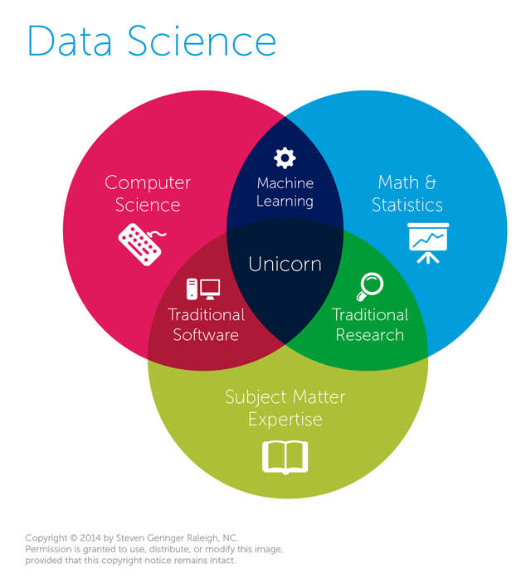
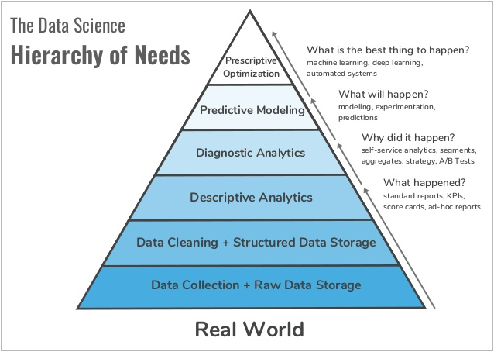
What is Data Science?
Data Science is a multidisciplinary field that uses scientific methods, processes, algorithms and systems to extract knowledge and insights from structured and unstructured data - Wikipedia

Slide 11
What is Data Science?
Data Science is a multidisciplinary field that uses scientific methods, processes, algorithms and systems to extract knowledge and insights from structured and unstructured data - Wikipedia

Slide 12
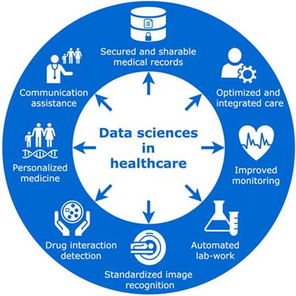
What is Health Data Science?
“Hiding within those mounds of data is knowledge that could change the life of a patient, or change the world.” – Atul Butte, Stanford School of Medicine
Health Data Science is data science for health / medical data
Data sets might originate from observational studies, clinical trials, computational biology, electronic medical records, health care claims, genetic and genomic epidemiology, environmental health, digital phenotyping, network science and many other fields
Precision medicine
Medical imaging
Predictive diagnostics
Natural language processing

Slide 13
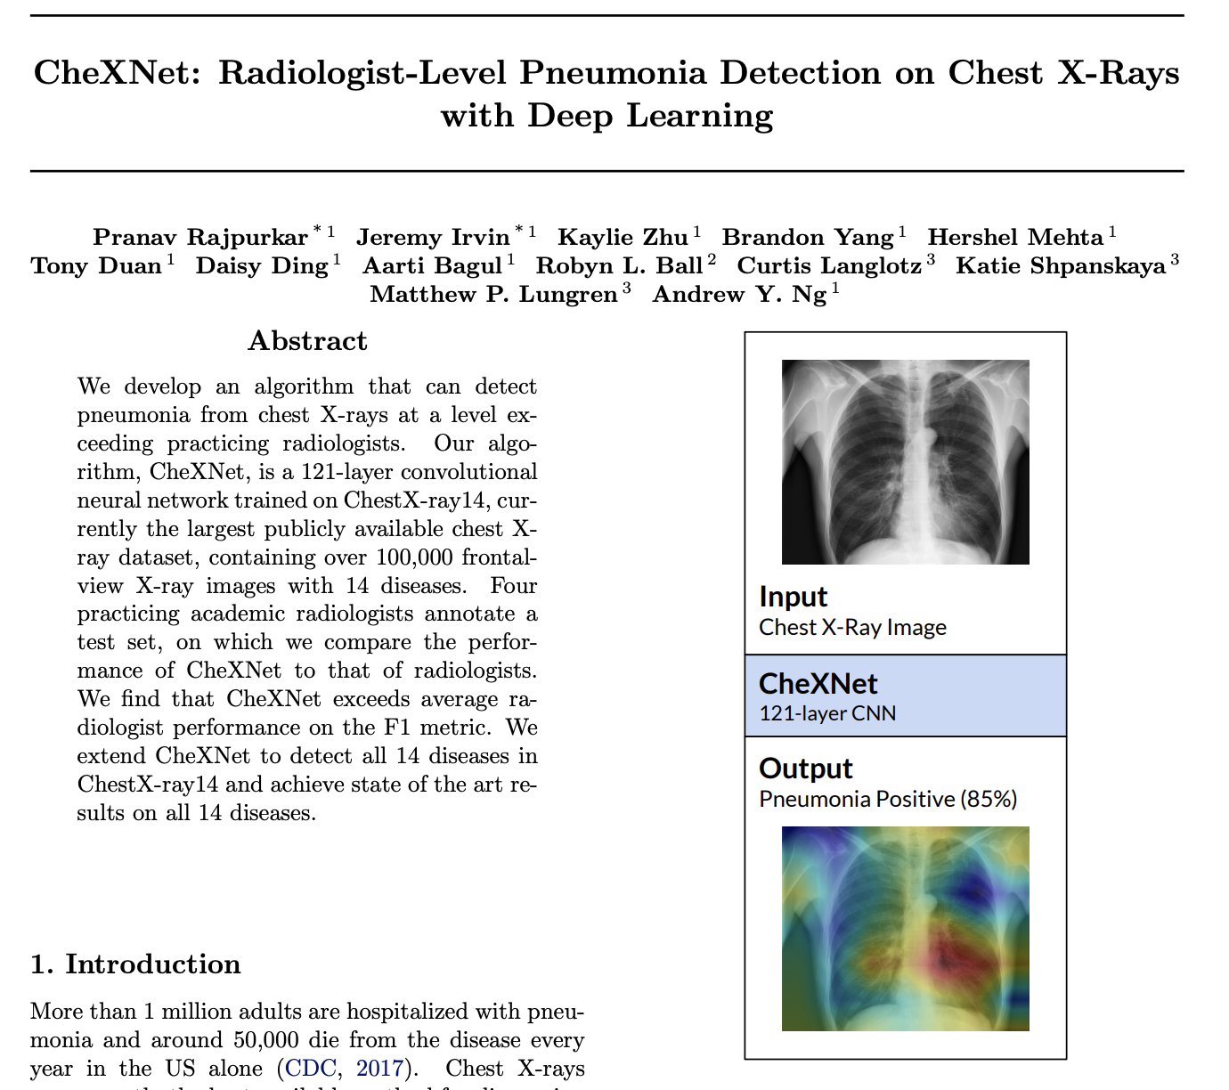
Data Science Success Stories

Slide 14
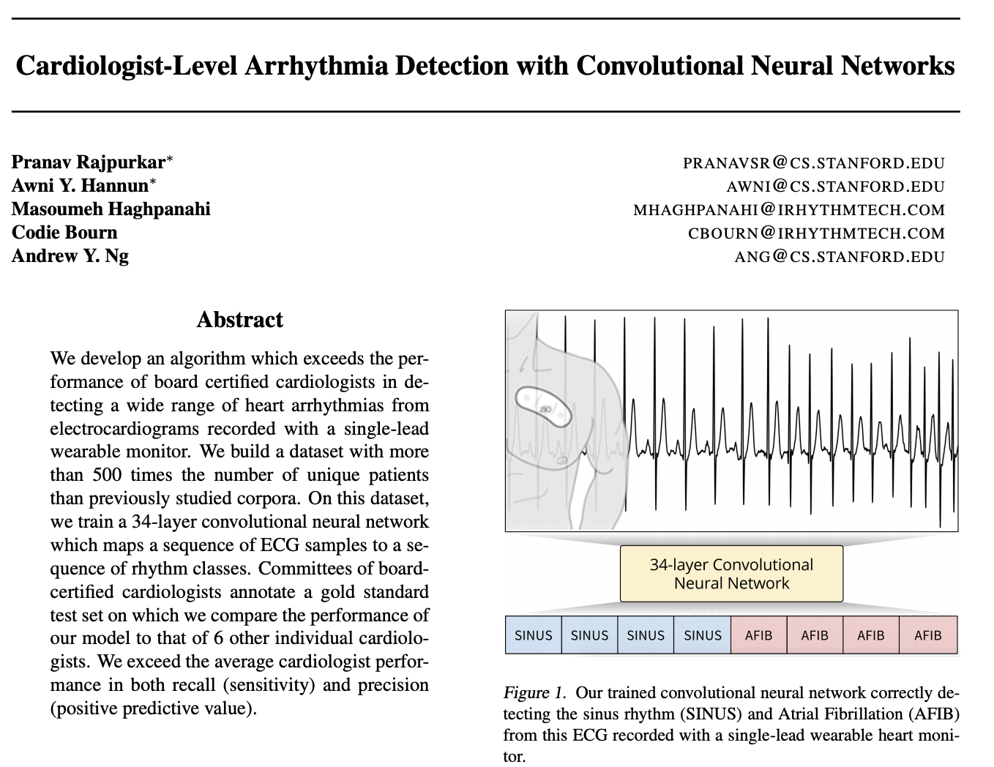
Data Science Success Stories

Slide 15
Data Science Success Stories
Many more examples
Personalized medicine
Medical diagnostics
Spell checkers
Natural language processing
Language translators
Etc.

Slide 16
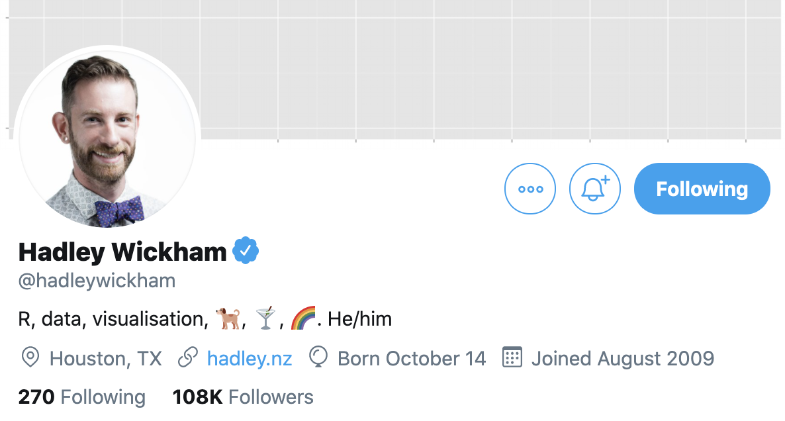
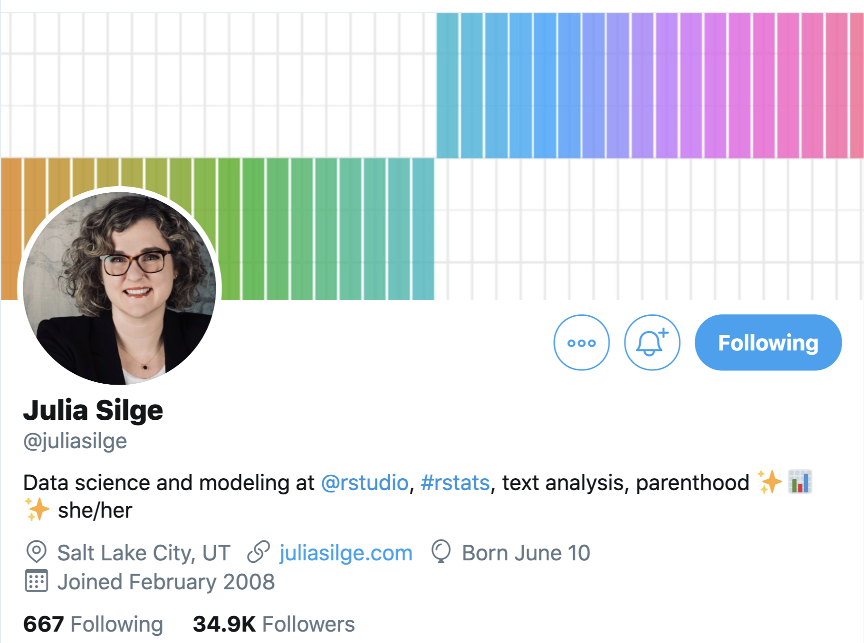
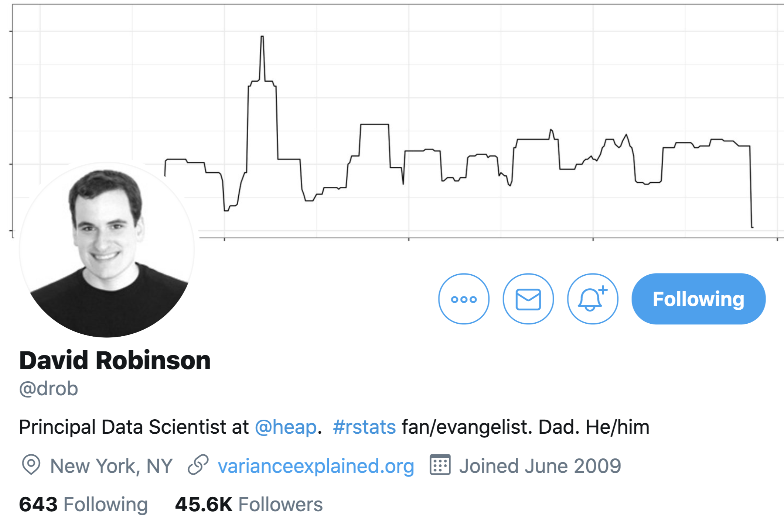
R/RStudio Resources
RStudio website
Hadley Wickham’s Twitter
Hadley Wickham’s GitHub
Hadley Wickham’s Shiny
R for Data Science
Introduction to Data Science
Introduction to Data Science course GitHub repository
Julia Siege’s Twitter
David Robinson’s Twitter
Text Mining with R

